Slide 1
cfsd What is the Impact of Digital Tools on Literacy Skills in the Elementary School Setting?
By: Alex Zurek and Gabrielle Antalffy

Slide 2
Topic
What is the impact of digital tools on literacy skills in the elementary school setting?
Digital Tools
Literacy Skills
What are your thoughts?
Notes:
We researched the question:
What is the impact of digital tools on literacy skills in the elementary school setting? We also looked into which digital tools, if any, are most beneficial for increasing literacy skills in the elementary school setting?
Digital Tools:
e-books, iPads, computers and/or devices, and apps or computer programs.
Literacy Skills:
word recognition, fluency, and reading comprehension.
Word recognition- ability to accurately identify letters and words, primarily in the early elementary stages.
Fluency- the ability to read aloud accurately, at a steady pace, and with expression.
Reading comprehension- ability for a child to read a text and recount the information and events accurately.

Slide 3
Problem
According to the National Center of Education Statistics (2011), the following groups of fourth-grade students were reading below basic levels:
51% African American
49% Hispanic
53% Native American
Notes:
BCPS has such a diverse population of students
1 to 1 devices were rolled out in the past few years
Teachers should utilize technology given to them in a way to benefit student learning
We were curious to see if the use of technology could be used to increase their reading and literacy skills

Slide 4
Significance
Literacy skills are important
This review is beneficial to all teachers and educators
Educators should be aware of research on struggling readers
Notes:
Literacy skills are important because children should be able to identify letters, read words fluently, and comprehend what they are reading in order to be successful in all other subject areas.
This review is beneficial to all teachers and instructors because students need to learn to read in order to be successful in not only reading/language arts, but in all other subjects as well.
Students will not fall behind as they move into the later grades. If they are able to read and comprehend texts successfully, then this skill will transfer into other subject areas.
Students who struggle with the foundational reading skills in the primary grades fall further behind their peers as they move into the intermediate and higher grades
Personal experience: 3rd grade, many students are behind on their reading levels. We use iReady which is a county wide program, but we also use the devices with various programs. Assign different leveled texts, customized assignments, website with specific games, etc.

Slide 5
Synthesis of Research
E-Books vs. Traditional Printed Books
Reading on different mediums
Reading with provided digital tools
Use of apps/computer programs
Engagement
Notes:
E-Books vs. Traditional Printed Books: no difference in fluency or reading comprehension with the use of e-books as opposed to traditional printed books when students were simply just reading the text.
When tools were available to use when reading the e-books (such as narration, highlighted words, dictionary, and musical cues), the children’s comprehension increased.
When technology and apps were provided for instruction, it was found that the children’s foundational phonics skills improved. These foundational phonics skills include letter recognition, sight word fluency, and phonemic awareness.
App- on the iPad called “The Sight Words: Kids Learn App” helped target sight word fluency
Computer program- “Alphie’s Alley” and Early Reading similar to iReady in BCPS
It was also found that students overall enjoyed reading with the technology over the traditional printed sources.

Slide 6
Evaluation of Research
Reliability
Our Evaluation
All stated their methods and procedures
Included results
Peer reviewed
Credible journals
Larger groups of students
Extended amount of time per study
Same test, different districts
Notes:
After analyzing several studies and their data points, the research methods were sound and we would expect similar results would occur repeated again.
We would conduct the same tests, but in a variety of areas and districts with diverse populations in order to compare and contrast results

Slide 7
Conclusion
Technology and digital tools can be used to help improve literacy skills in young learners, if used appropriately
Educators can use a variety of digital tools as interventions
Teachers should be aware of the rapid changing of technology and its benefits
Notes:
Educators can use a variety of digital tools as interventions to help students who are performing below grade level with early reading skills.
As technology continues to advance, teachers should become aware of the digital tools available in order to enhance students’ literacy skills.
Computer programs and apps are valuable tools to use in the classroom because it gives the teacher the ability to customize instruction for each students’ needs. We believe that if students are motivated and engaged in their work, then they are more likely to be successful in the classroom.

Slide 8
Discussion and Questions
What types of technology do you use with your students? How does it affect them?
Questions?

Slide 9
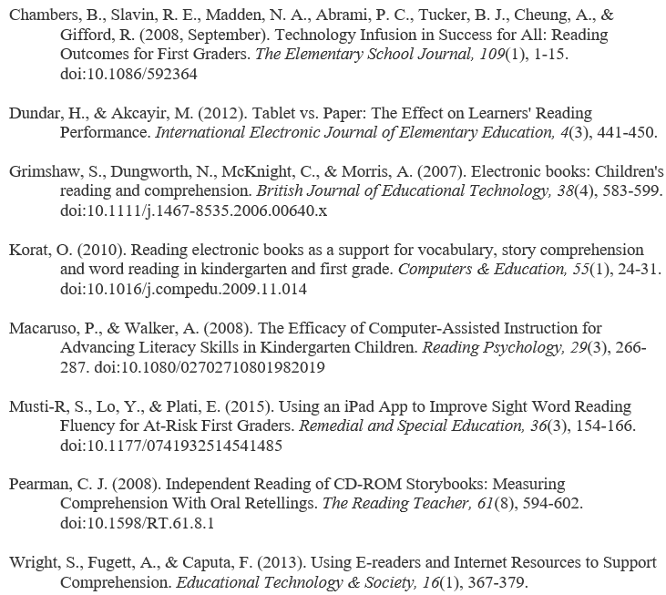
References

